Slide 1
Information from data
Silvia Caldararu
Email: caldaras@tcd.ie

Slide 2

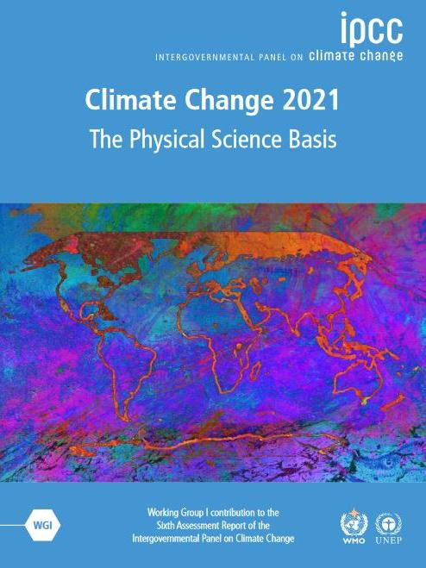
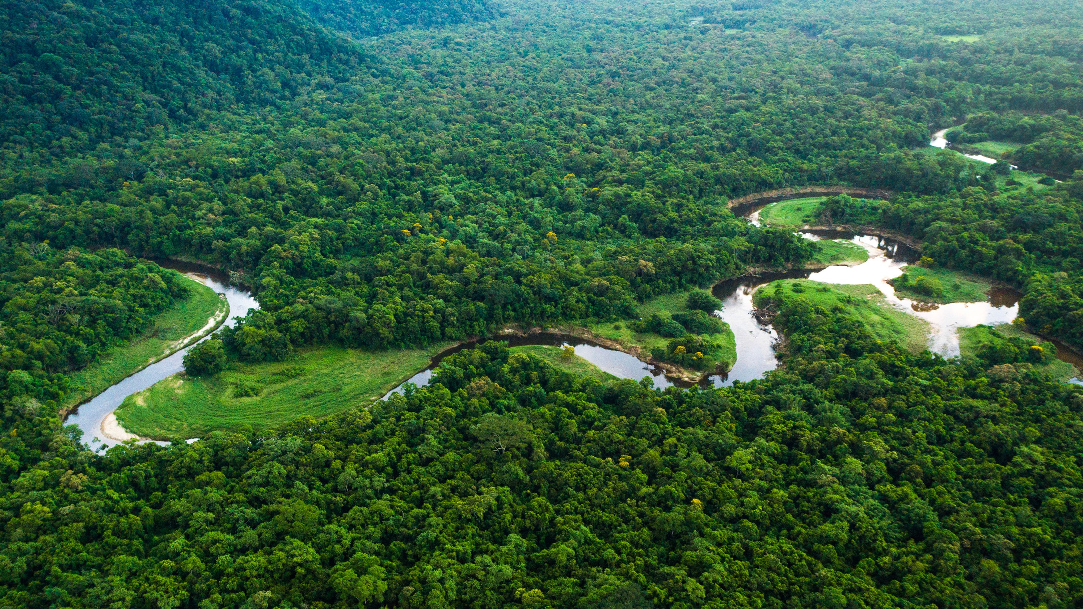

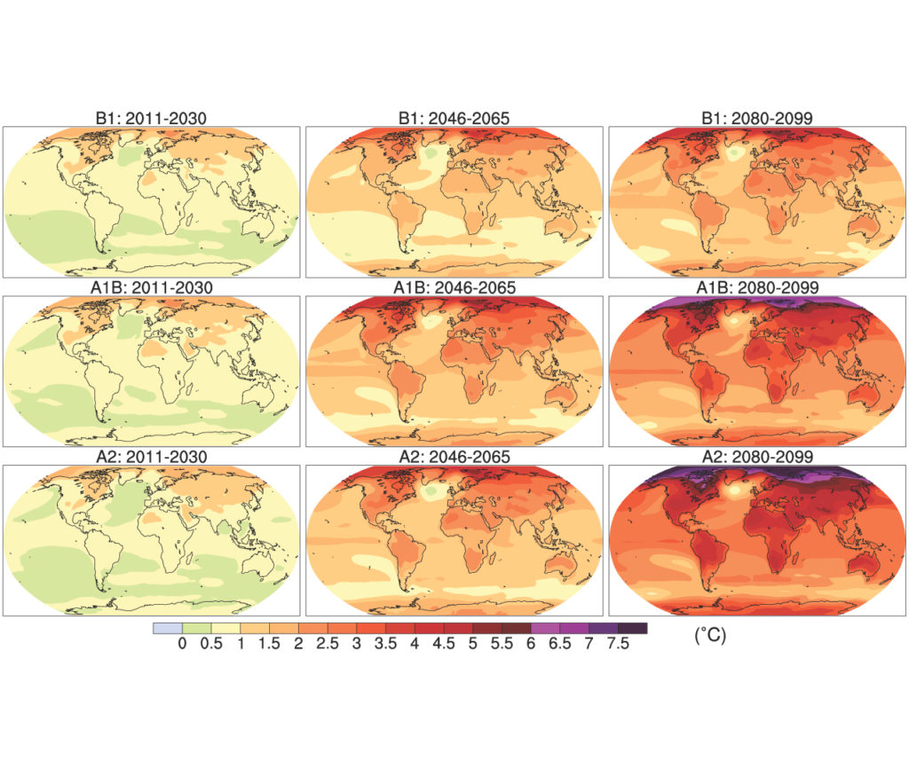
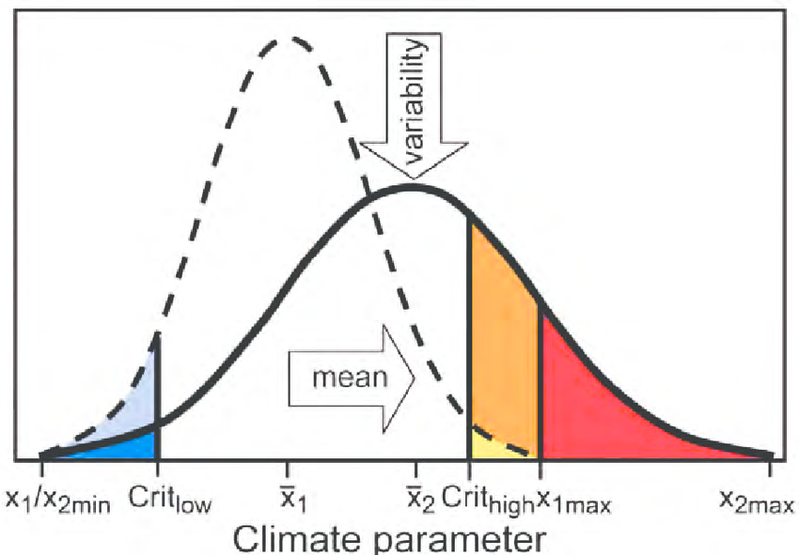
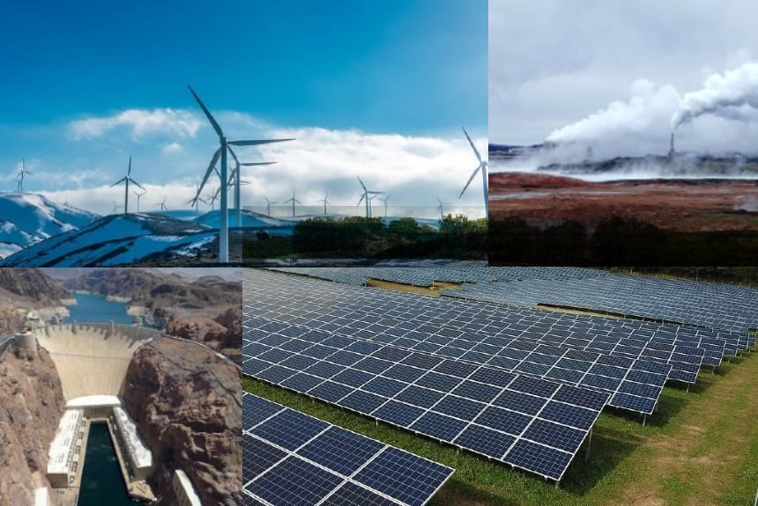
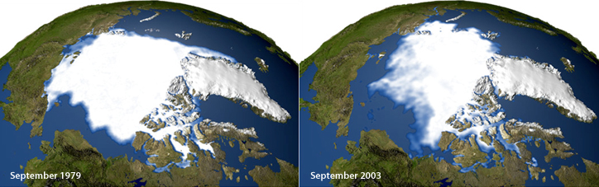
Atmosphere
Climate fundamentals
Predicting climate
Atmosphere
Global C cycle
IPCC report
Earth system models
Climate impacts
Climate solutions
Extreme events
Tipping points
Sea ice, ice caps,
Energy
Mitigation
Nature-based solutions

Slide 3
Multi-dimensional data
Time:
1850-2100
Space: lat/lon grid
Multiple variables: temperature, precipitation etc.
SSPs:
4 tier 1, 4 tier 2
Earth System Models:
10-30 per SSP

Slide 4
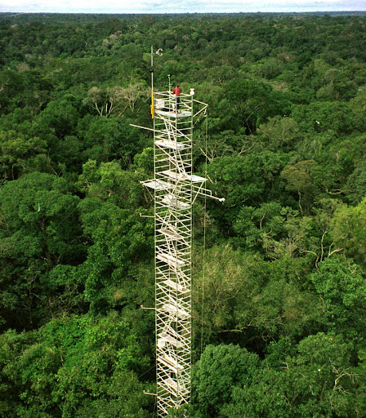
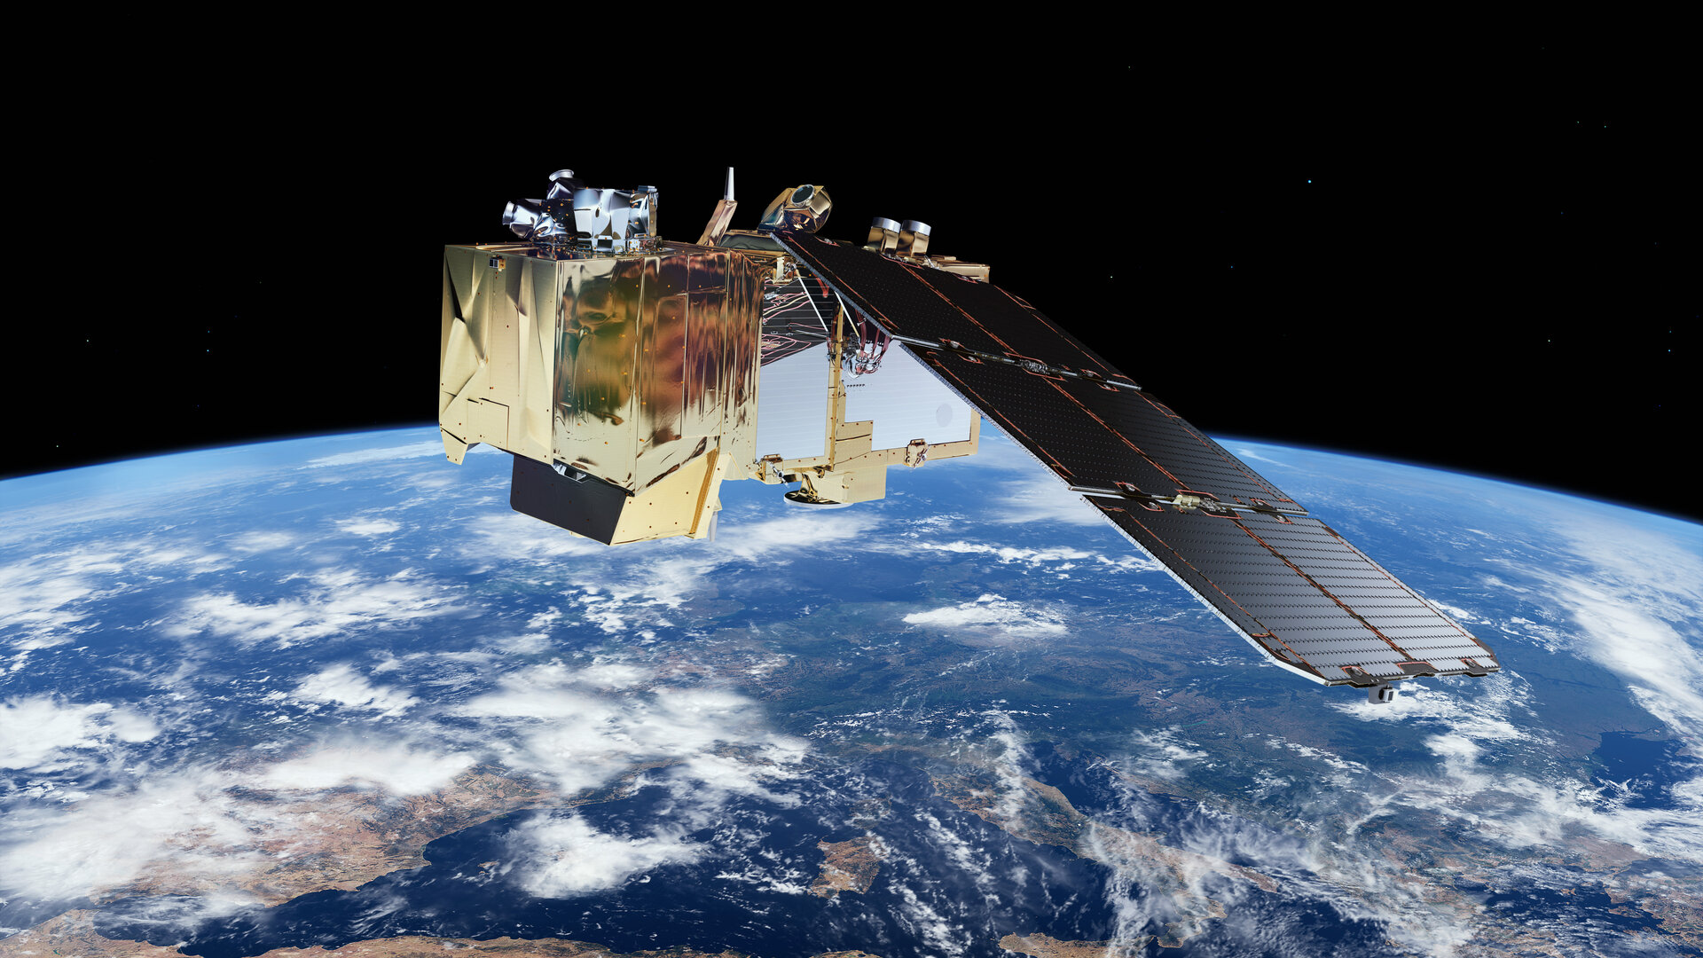

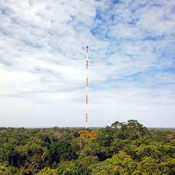
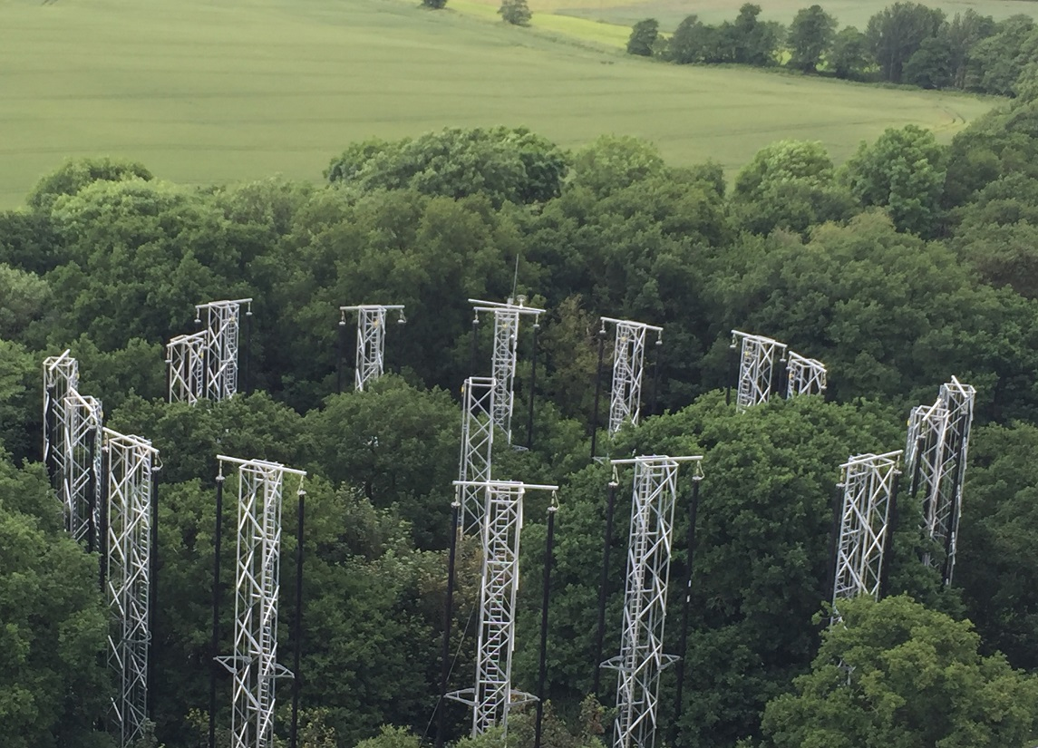
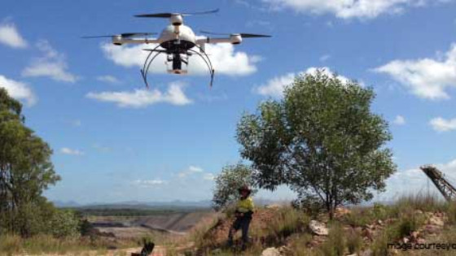
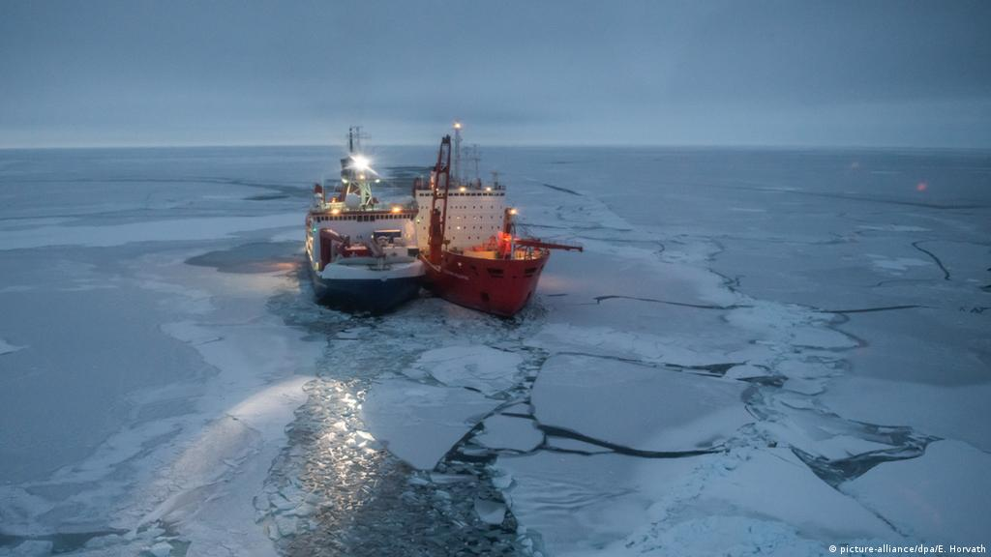

A data rich world
Reasoning from this lecture more generally applicable to other data

Slide 5

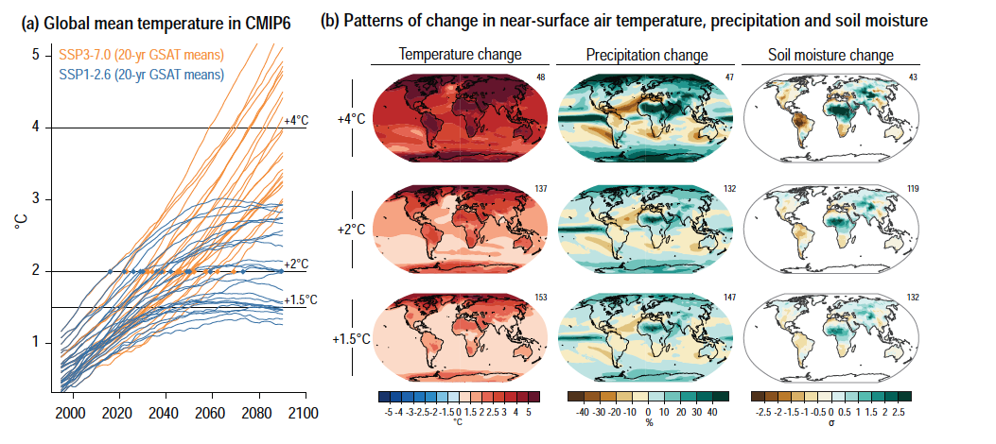
From data to information
Data – a collection of numbers
Information – processed data to answer specific questions

Slide 6
Questions in the context of future climate
What is the global time trajectory of the climate?
Will there be changes in the seasonality of temperature or precipitation?
How bad can it get? What are the possible extreme climate conditions?
How are different regions of the world affected by climate change?

Slide 7
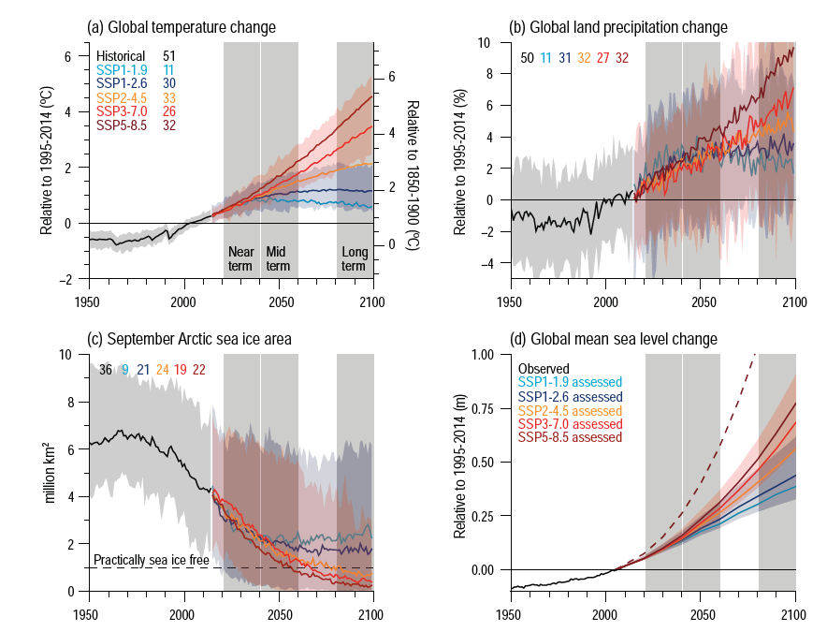
What is the global time trajectory of the climate?
Global mean for each year for each model
Mean of all models for each year
Range of all models for each year

Slide 8
Model means but never SSP means
Model uncertainty and scenario uncertainty are treated differently
A mean of SSPs does not provide meaningful information for decision making

Slide 9
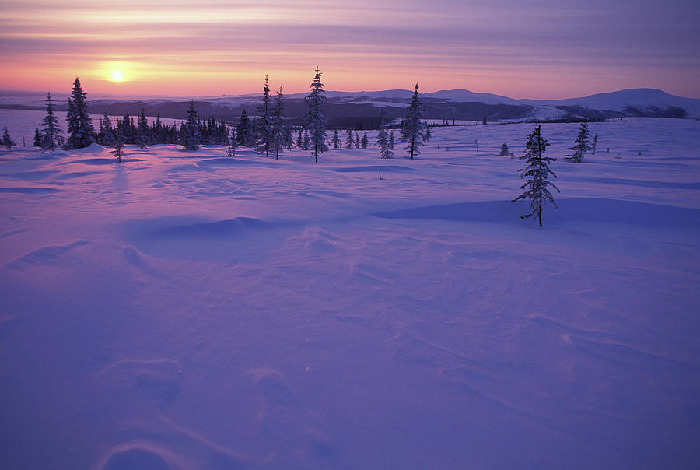

Not all temperatures are created equal
The mean temperature in 2100 is going to be 25ºC
The mean temperature in 2100 is going to be 25ºC

Slide 10
Initial conditions uncertainty
Mean global temperature in 1850 was 13.5 C and we are seeing an increase of 0.5 C
Mean global temperature in 1850 was 14.2 C and we are seeing an increase of 0.5 C

Slide 11
Anomalies
Anomaly = predicted variable – mean reference value

Slide 12
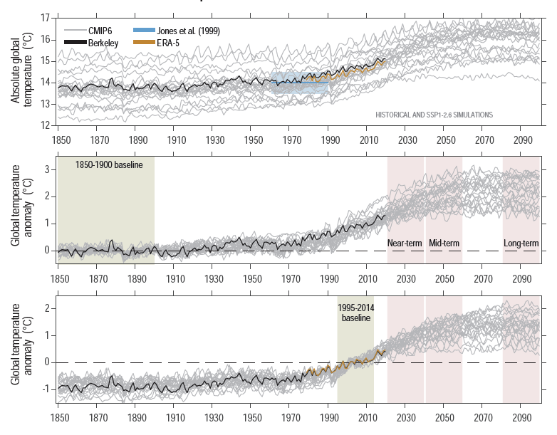
The reference historical period

Slide 13
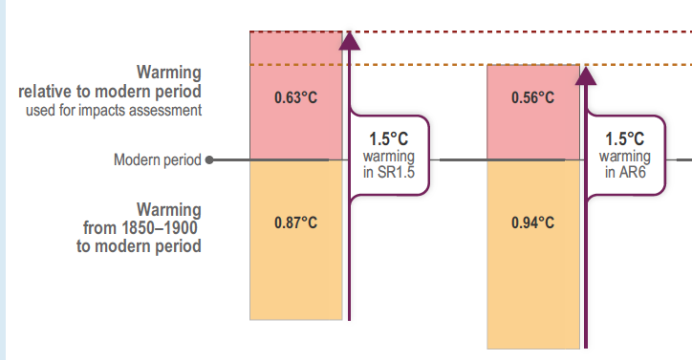
Global warming level targets

Slide 14
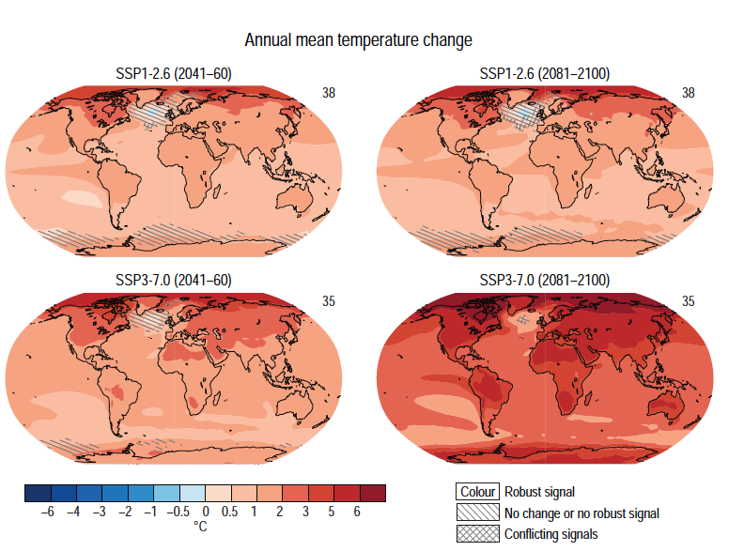
What is the geographical distribution of change?
Mean for all models in each grid cell
Mean over a given year range
Practical 3

Slide 15
Uncertainty on a map
Solid colour – robust signal i.e. models agree on direction of change
Line pattern – no change or no signal. No statistical significance
Chequered pattern – models do not agree, i.e. model predict change in opposite directions

Slide 16
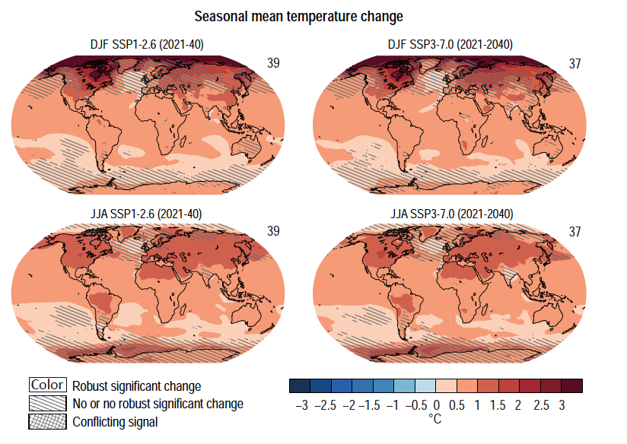
Seasonal changes
Mean of all models over a given period for three months in each grid cell

Slide 17
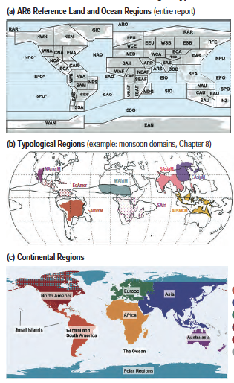
Regions used in the IPCC

Slide 18
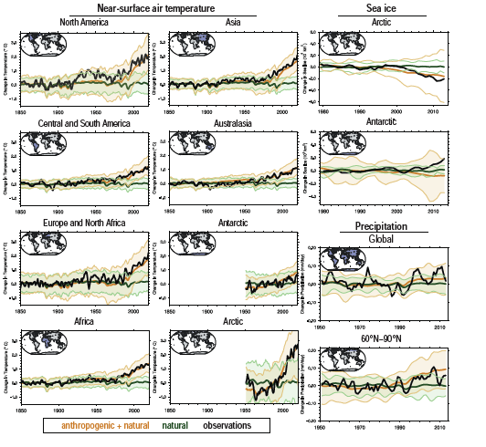
What is the regional time trajectory of the climate?
Regional mean for each year for each model
Mean of all models for each year
Range of all models for each year

Slide 19
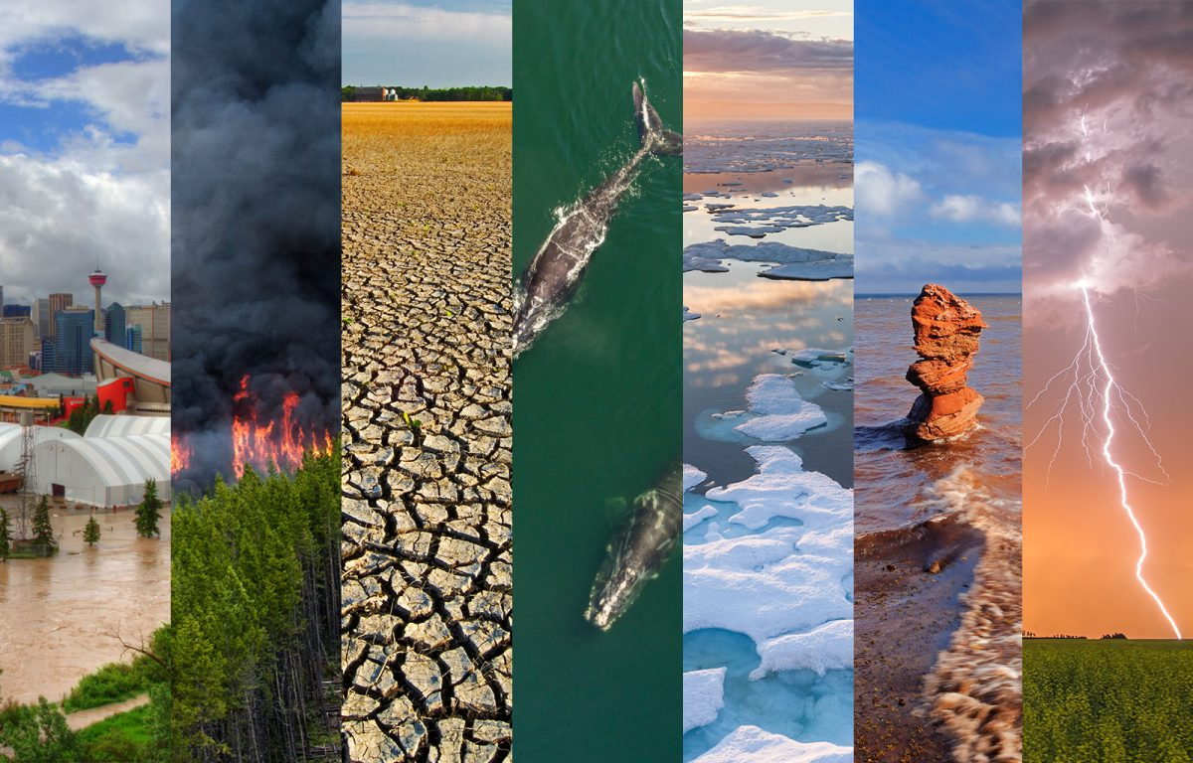
Extreme events
Extreme weather event: ‘an event that is rare at a particular place and
time of year’
Extreme climate event as ‘a pattern of extreme weather that persists for some time, such as a season’

Slide 20
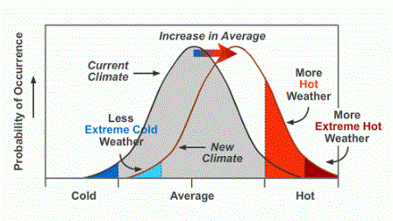
Extreme events
Relatively small shifts in the mean lead to large changes in the tail of the distribution

Slide 21
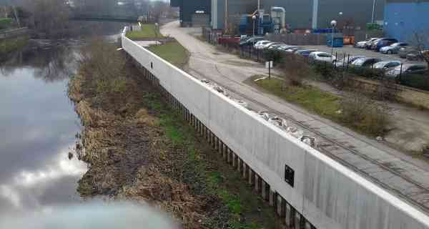
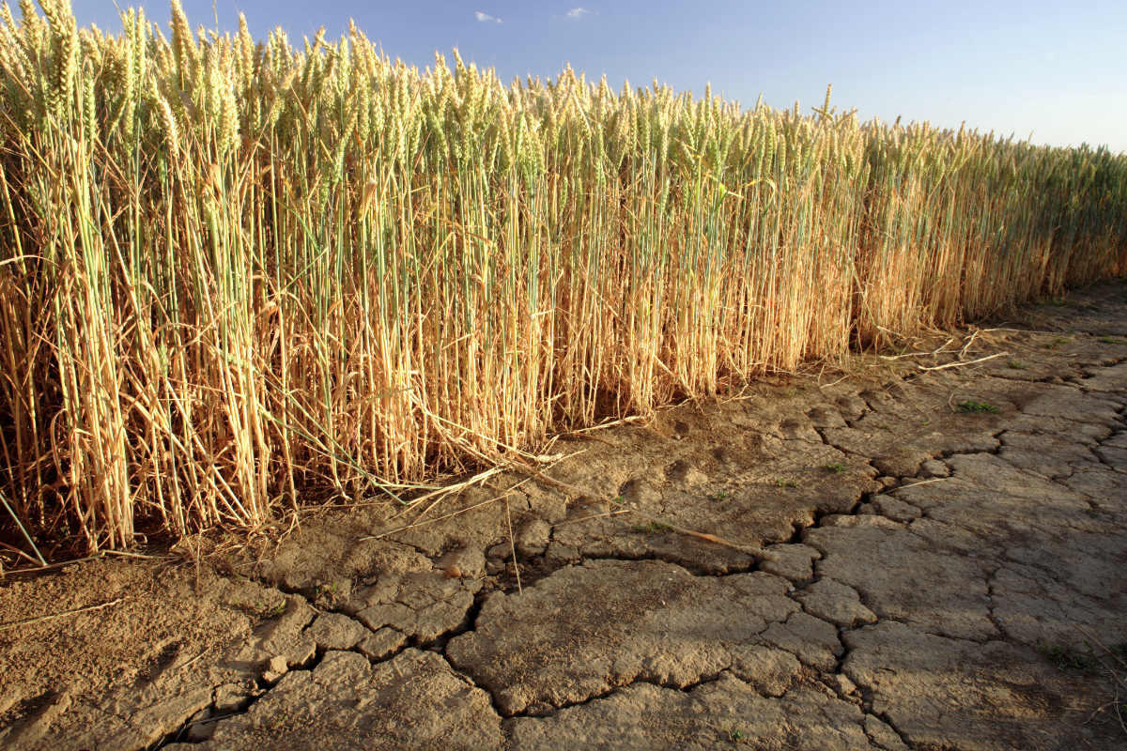
Low likelihood high impact extremes
Extremise events cause large economic and societal damage
Defences and risks are calculated based on historical data e.g. for a 1 in a 100 year event

Slide 22
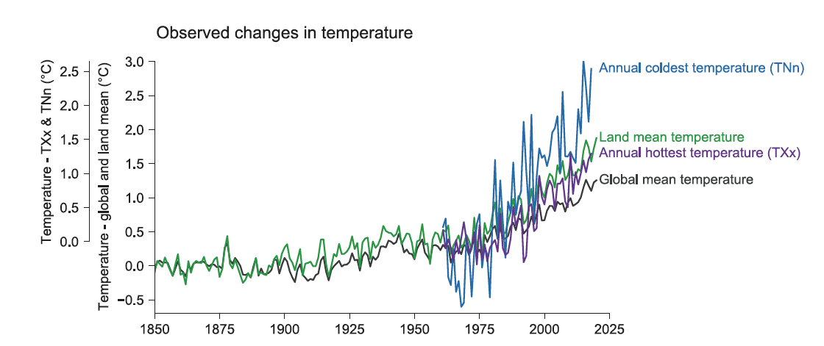
Change over time in extreme climate values
Same as for the global mean but looking at minimum and maximum values

Slide 23
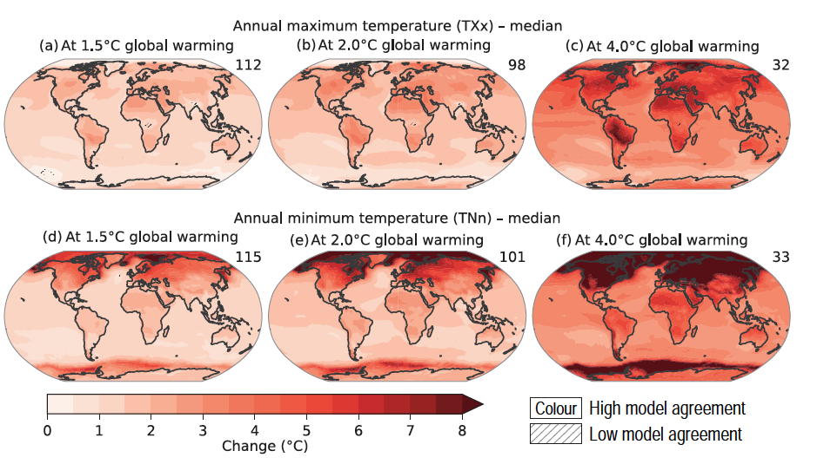
Global distributions of extreme values
Same as for the global mean but looking at minimum and maximum values
Anomaly calculated based on the median value to account for spatial differences

Slide 24
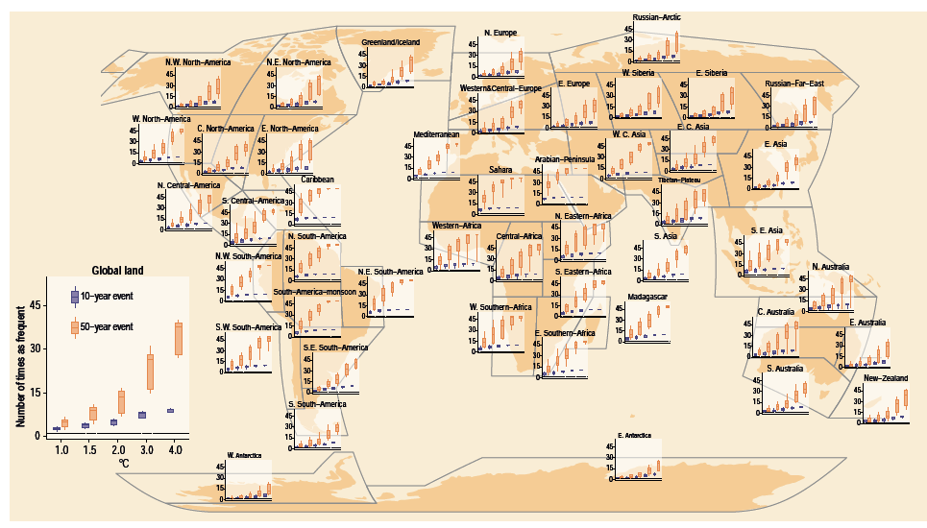
Changes in frequency of extreme events
Moving from magnitude to how many times an event will happen.
Related to how we calculate risk e.g. 1 in a 100 year event
Most useful to report at regional level as this is where decisions are made

Slide 25
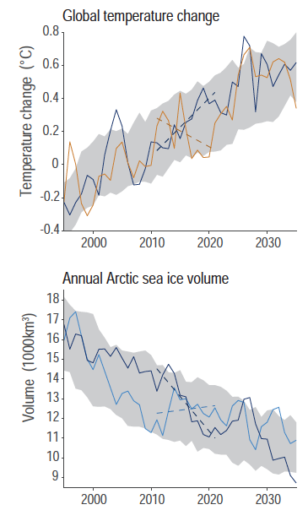
Attribution
Given natural variation in climate and weather how do we attribute observed or predicted changes to anthropogenic effects?

Slide 26
Attribution
Attribution of observed changes in natural or human systems to
climate-related drivers
Attribution of weather and climate events to anthropogenic forcing
Attribution of observed climate change to anthropogenic forcing
Attribution of changes in atmospheric greenhouse gas concentrations to anthropogenic activity

Slide 27
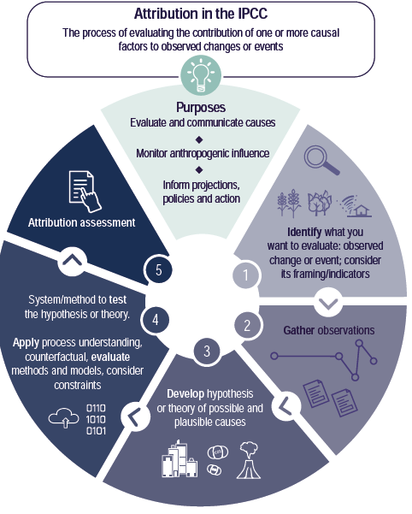
Attribution
Gathering multiple lines of evidence, e.g. observations, theory
Statistical methods
Notes:
https://www.worldweatherattribution.org/ and https://link.springer.com/article/10.1007/s10584-021-03071-7

Slide 28
Attribution – single step, process-based
Attribution of changes in atmospheric greenhouse gas concentrations to anthropogenic activity
Attribution of observed climate change to anthropogenic forcing

Slide 29
Attribution – process and observational evidence
Attribution of observed changes in natural or human systems to
climate-related drivers

Slide 30
Attribution – process and observational evidence and statistical methods
Attribution of weather and climate events to anthropogenic forcing

Slide 31
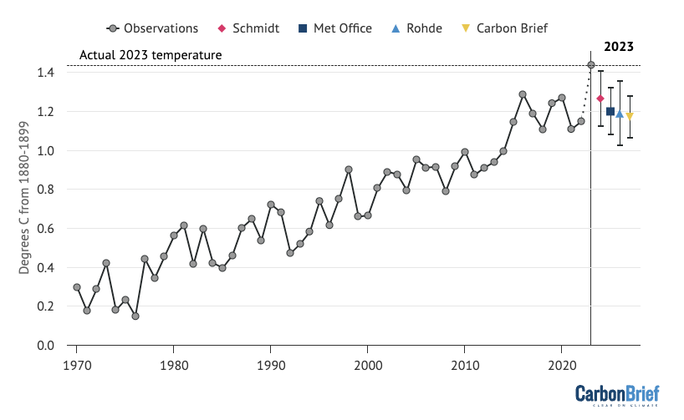
Explaining extreme heat in 2023
Notes:
https://www.carbonbrief.org/state-of-the-climate-2023-smashes-records-for-surface-temperature-and-ocean-heat/

Slide 32
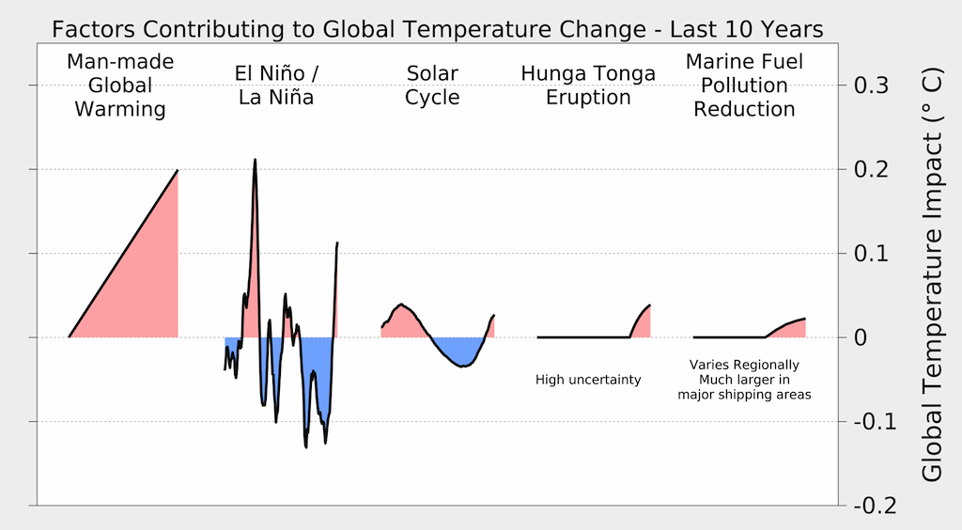
Explaining extreme heat in 2023

Slide 33
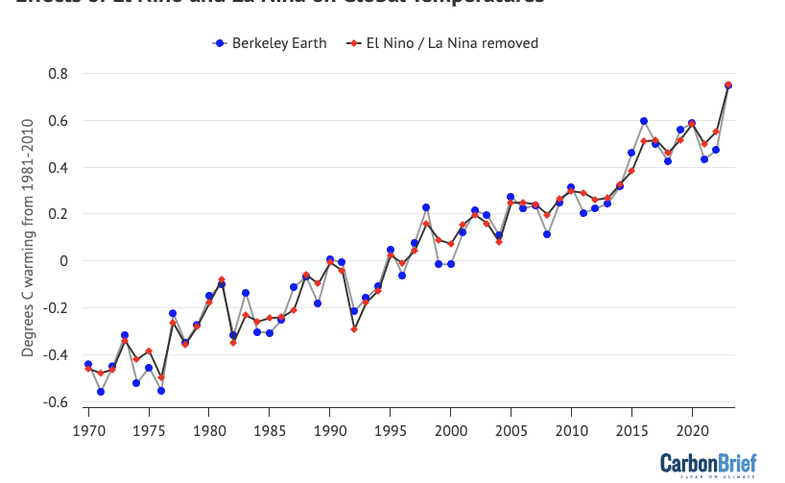
Explaining extreme heat in 2023
Effect removed based on previous observed relationships

Slide 34
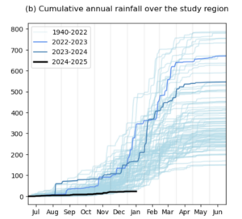
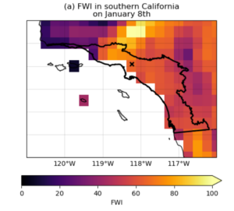
California fires January 2025
Area under high risk of fire historically
Extremely low precipitation and high wind speeds
Model simulations with and without climate change show a 6% increase in intensity and 35% more probably
Fire weather index
Notes:
https://www.worldweatherattribution.org/climate-change-increased-the-likelihood-of-wildfire-disaster-in-highly-exposed-los-angeles-area/

Slide 35
Attribution
A workflow rather than a set recipe – no one size fits all algorithm for attribution
Notes:
https://www.worldweatherattribution.org/ and https://link.springer.com/article/10.1007/s10584-021-03071-7

Slide 36
Atmosphere
Climate fundamentals
Predicting climate
Atmosphere
Global C cycle
IPCC report
Earth system models
Climate impacts
Climate solutions
Extreme events
Tipping points
Sea ice, ice caps,
Energy
Mitigation
Nature-based solutions

